Slide 1





ROUTE
CONNOISEUR
ROUTE
CONNOISEUR

Slide 2


Personal Info
Reasons for choosing the topic:
R
C
ROUTE
CONNOISEUR
ROUTE
CONNOISEUR
Name: Gia Han
Age: 14
Class: JSI
From: Binh Duong
Staff: Hong Ngan

Slide 3
Personal Info
Name: Gia Han
Age: 14
Class: JSI
From: Binh Duong
Staff: Hong Ngan

Slide 4
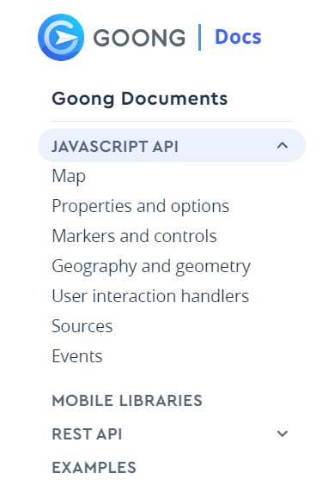
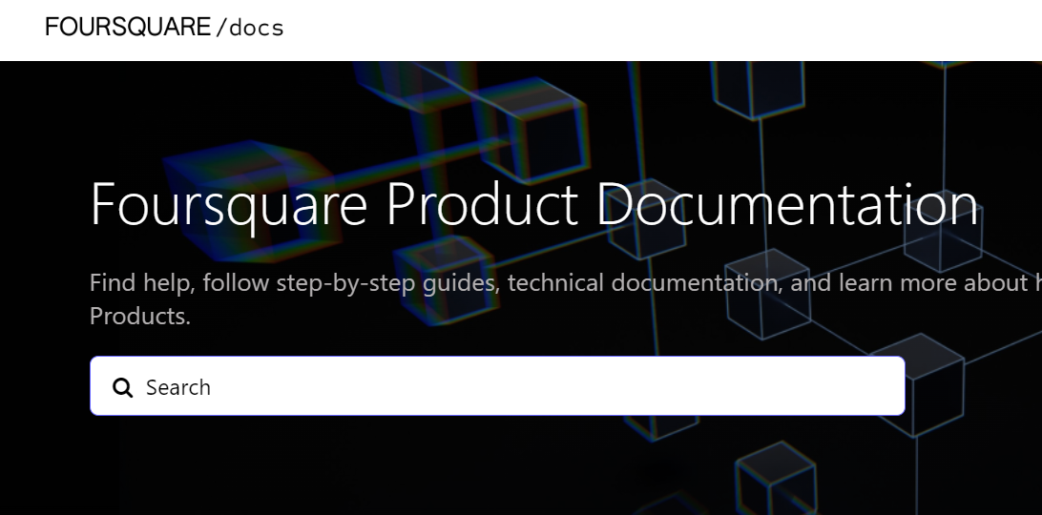
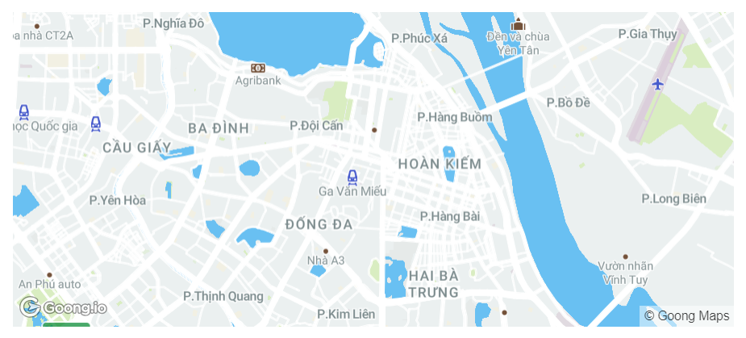
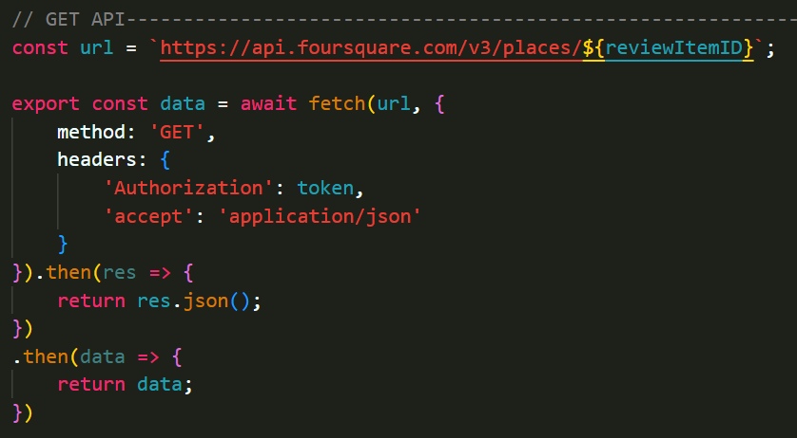
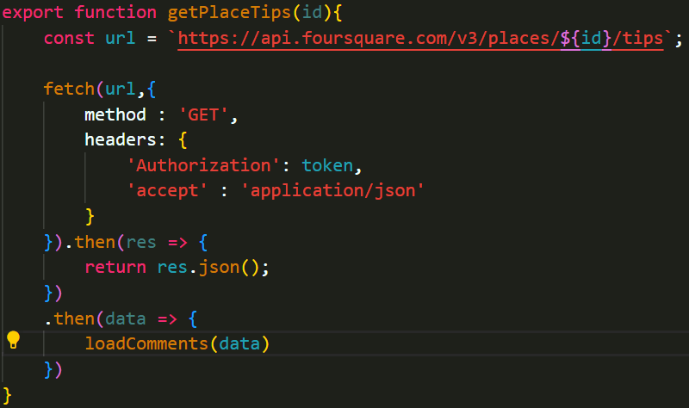
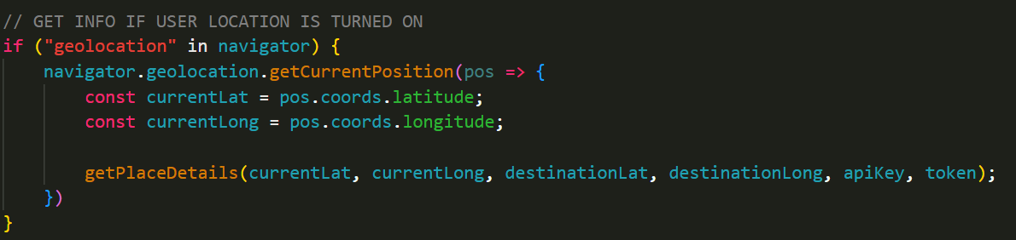
API
Place Search from FourSquare
Rest API from GOONG

Slide 5
API
Place Search from FourSquare
Rest API from GOONG

Slide 6


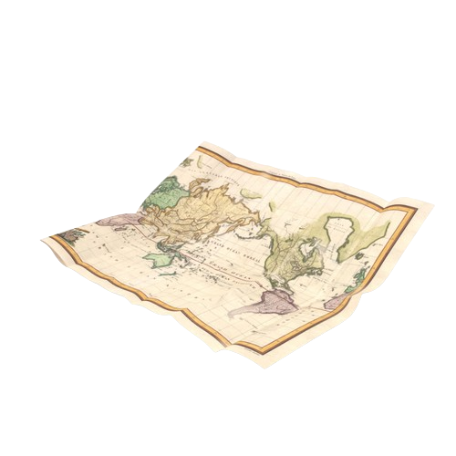
Reasons for choosing the topic:
- Entertainment needs of young people
- Save time
- Helps users remember locations
- Find nearby locations, according to the type users may like

Slide 7
- Entertainment needs of young people
- Save time
- Helps users remember locations
Reasons for choosing the topic:
- Find nearby locations, according to the type users may like
Feature:
- Entertainment needs of young people
- Providing a variety of entertainment, entertainment, dining, etc. places for users
- Save time
- Helps users remember locations
- Categorize locations so users can search and choose conveniently and quickly
- Find nearby locations, according to the type users may like
- Provide many pictures of the location, reviews from previous users and previous customers of the location so that users can consider carefully
- Give directions and draw directions on the map so users can get to places easily, saving time
- Give directions and draw directions on the map so users can get to places easily, saving time
- Allows users to add comments about selected and experienced places
- Save access history of user's favorite locations and lists
- Show the most attractive locations around the user's address
- Suggest places users may like based on the location the user has just visited
- Displays information about the selected location: distance, arrival time, location type, location, location name
- Log in and register so users can manage their accounts and edit their personal pages

Slide 8
Reasons for choosing the topic:
Feature:
- Entertainment needs of young people
- Allows users to add comments about selected and experienced places
- Save time
- Helps users remember locations
- Save access history of user's favorite locations and lists
- Find nearby locations, according to the type users may like
- Show the most attractive locations around the user's address
- Suggest places users may like based on the location the user has just visited
- Displays information about the selected location: distance, arrival time, location type, location, location name
- Log in and register so users can manage their accounts and edit their personal pages
- Providing a variety of entertainment, entertainment, dining, etc. places for users
- Share locations via links, share personal pages via links for users to conveniently connect with friends
- Categorize locations so users can search and choose conveniently and quickly
- Admin page to manage users, edit permissions, delete and block unwanted users
- Provide many pictures of the location, reviews from previous users and previous customers of the location so that users can consider carefully
- Give directions and draw directions on the map so users can get to places easily, saving time
- Give directions and draw directions on the map so users can get to places easily, saving time

Slide 9



Languages
Reasons for choosing the topic:
Feature:
- Entertainment needs of young people
- Share locations via links, share personal pages via links for users to conveniently connect with friends
- Save time
- Helps users remember locations
- Admin page to manage users, edit permissions, delete and block unwanted users
- Find nearby locations, according to the type users may like
- Providing a variety of entertainment, entertainment, dining, etc. places for users
- Allows users to add comments about selected and experienced places
- Categorize locations so users can search and choose conveniently and quickly
- Save access history of user's favorite locations and lists
- Provide many pictures of the location, reviews from previous users and previous customers of the location so that users can consider carefully
- Show the most attractive locations around the user's address
- Suggest places users may like based on the location the user has just visited
- Give directions and draw directions on the map so users can get to places easily, saving time
- Displays information about the selected location: distance, arrival time, location type, location, location name
- Log in and register so users can manage their accounts and edit their personal pages
- Give directions and draw directions on the map so users can get to places easily, saving time
Javascript
CSS
HTML

Slide 10
Feature:
Languages
C
Javascript
CSS
HTML
- Share locations via links, share personal pages via links for users to conveniently connect with friends
- Admin page to manage users, edit permissions, delete and block unwanted users

Slide 11

Feature:
Languages
C
Javascript
CSS
HTML
≈ 1 month
- Share locations via links, share personal pages via links for users to conveniently connect with friends
- Admin page to manage users, edit permissions, delete and block unwanted users

Slide 12
Feature:
R
C
≈ 1 month
- Share locations via links, share personal pages via links for users to conveniently connect with friends
- Admin page to manage users, edit permissions, delete and block unwanted users

Slide 13
R
C

Slide 14
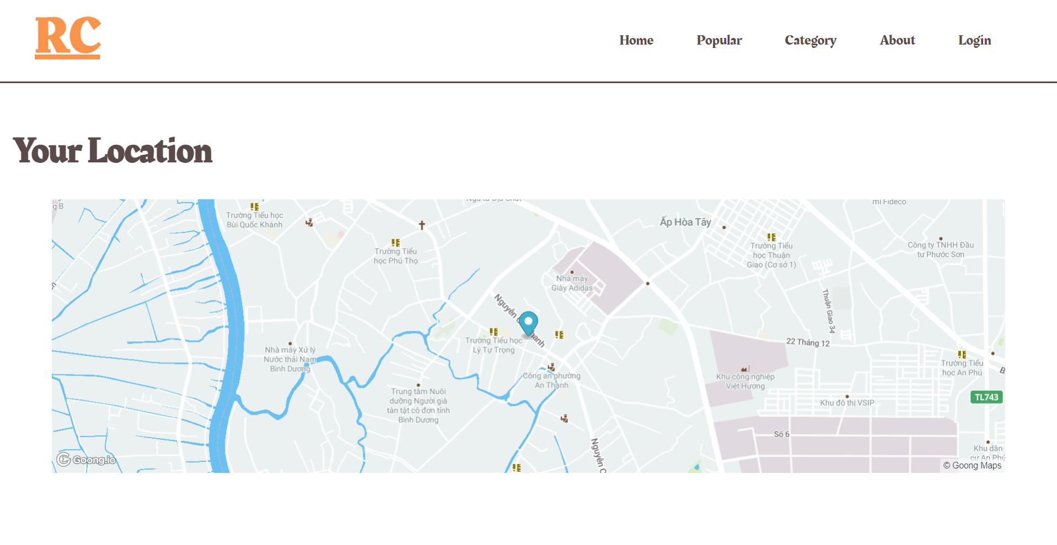
R
C
RC
DEMO

